Slide 1

Frontend Developer Overview
A Front-End Developer is a professional who designs and builds the visual parts of a website or web application that users interact with directly. They use technologies like HTML, CSS, JavaScript and React to create responsive and user-friendly interfaces. Their main goal is to ensure a smooth user experience across all devices and browsers. They work together with designers and back-end developers to make the website fully functional and good-looking.

Slide 2

About Me
Hello, my name is Mahmad Ayan Ansari and I’m From Nadiad.
I have completed my Bachelor of Computer Applications (BCA) and I am currently pursuing Frontend Development training at TOPS Technologies.
I am a passionate and detail-oriented Frontend Developer with a strong fundamental in HTML, CSS, JavaScript, and React . I have hands-on experience building responsive, user-friendly web applications, and I’m comfortable working with version control tools like Git and deploying applications through platforms like Vercel.

Slide 3

Understanding the Frontend
Frontend means the part of a website or app that users see and use directly — like buttons, menus, images, and forms. It’s what appears on your screen when you open a website.
components that is use in frontend is HTML, CSS, Bootstrap, JavaScript, and React.

Slide 4

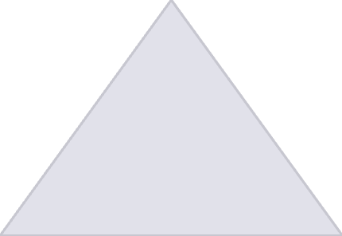
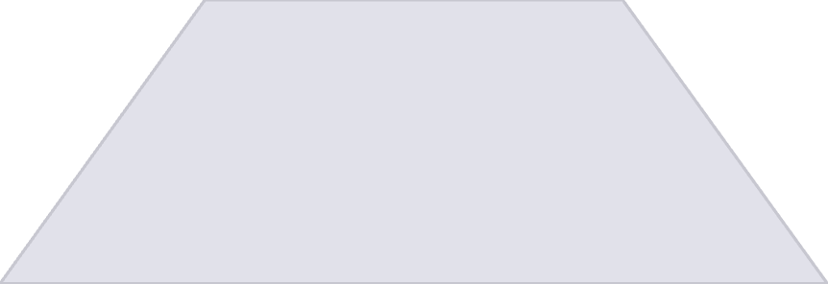
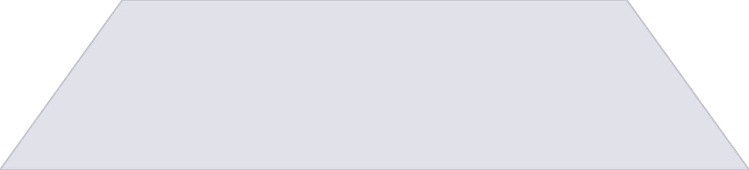
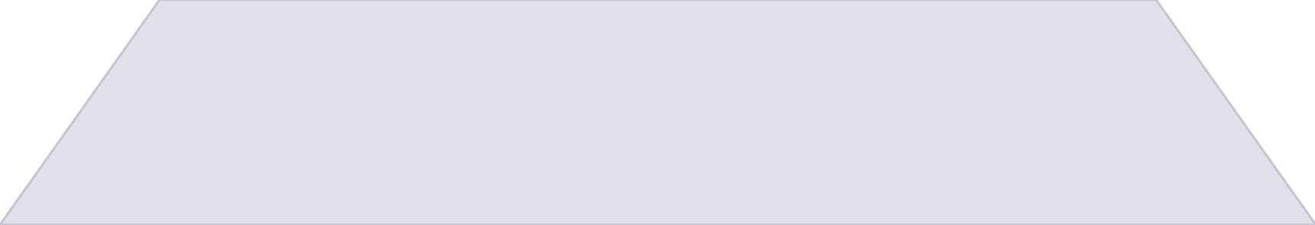
Frontend Components
HTML ( Hypertext Markup Language )
1
It builds the structure of a webpage.
CSS ( Cascading Style Sheets )
2
It adds style and design.
JavaScript
3
It makes the website interactive.
React
4
A JavaScript library for building UI.

Slide 5
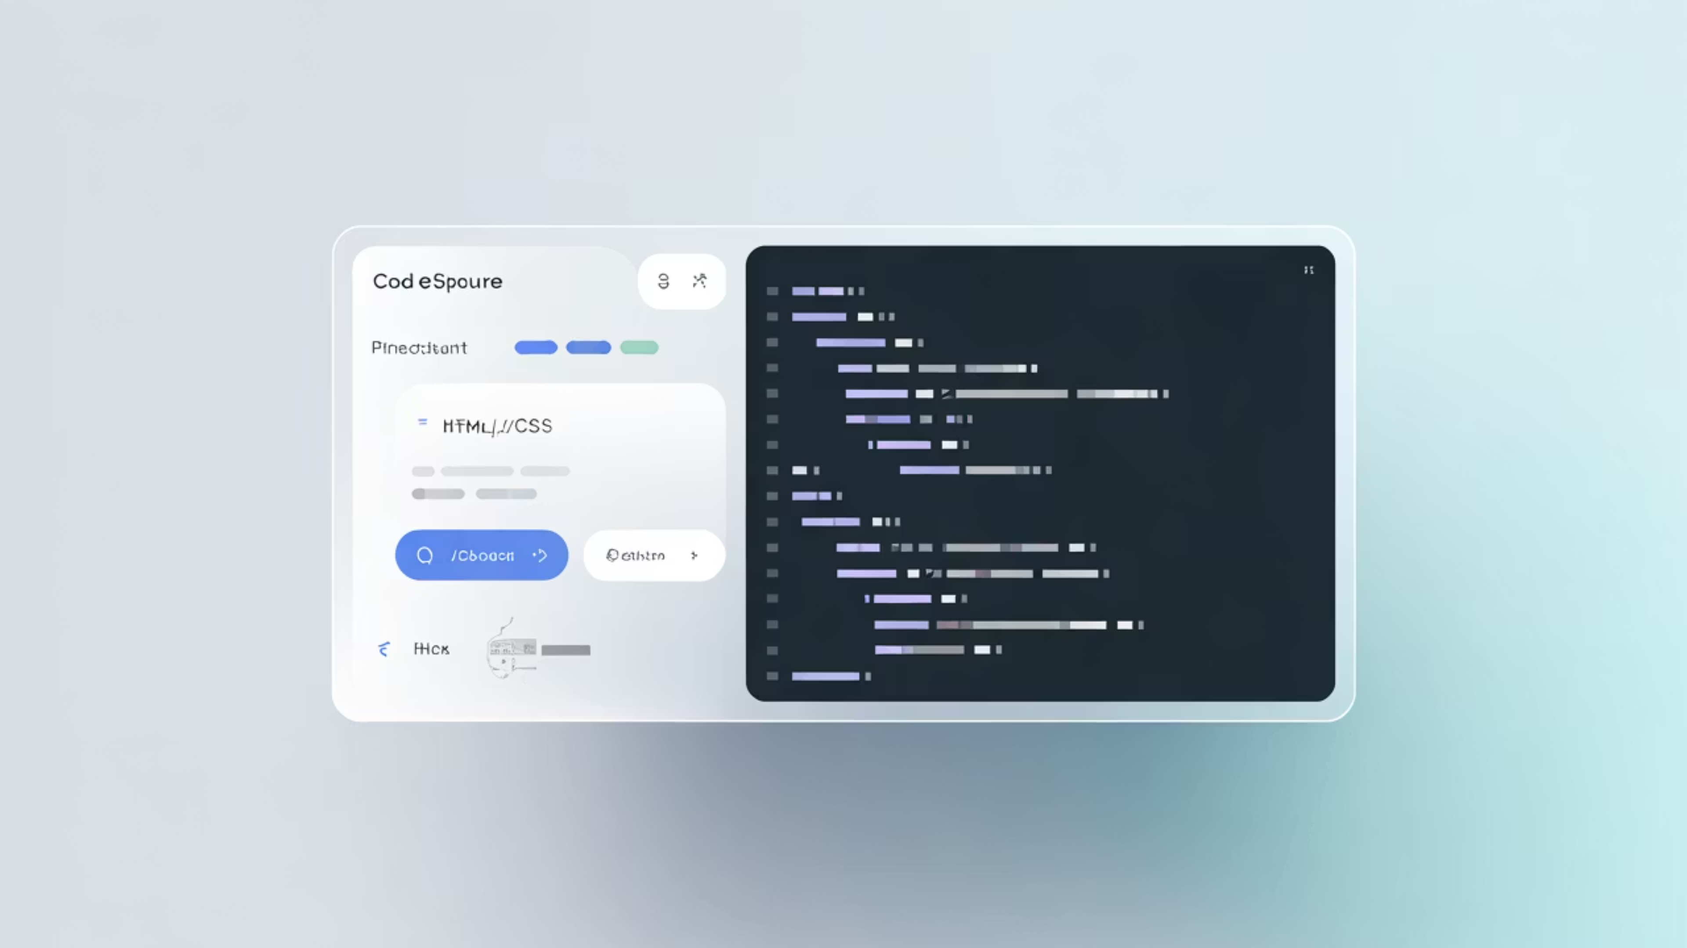
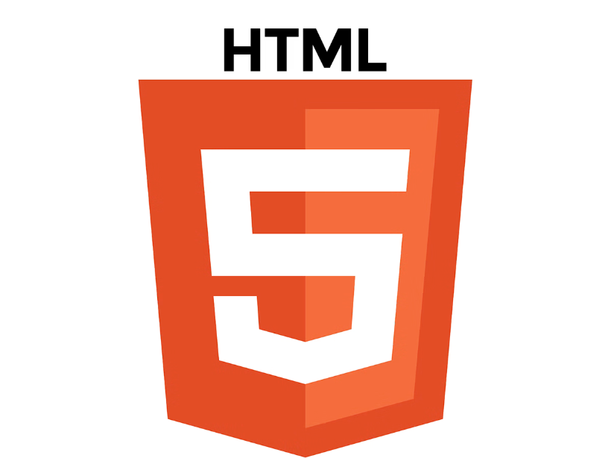
HTML Overview
HTML stands for HyperText Markup Language.
It is used to create the structure of a webpage.
It defines elements like text, images, links, and buttons.
It acts as the backbone of every website.

Slide 6
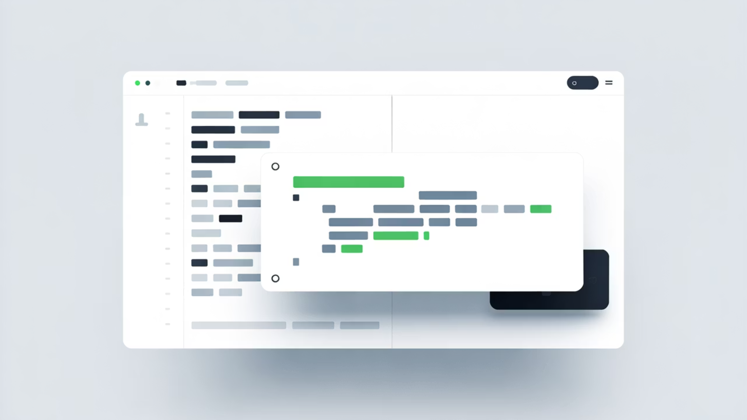

CSS Overview
CSS stands for Cascading Style Sheets.
It is used to style and design web pages.
It controls colors, fonts, layouts, and spacing.
It makes websites attractive and responsive on all devices.

Slide 7
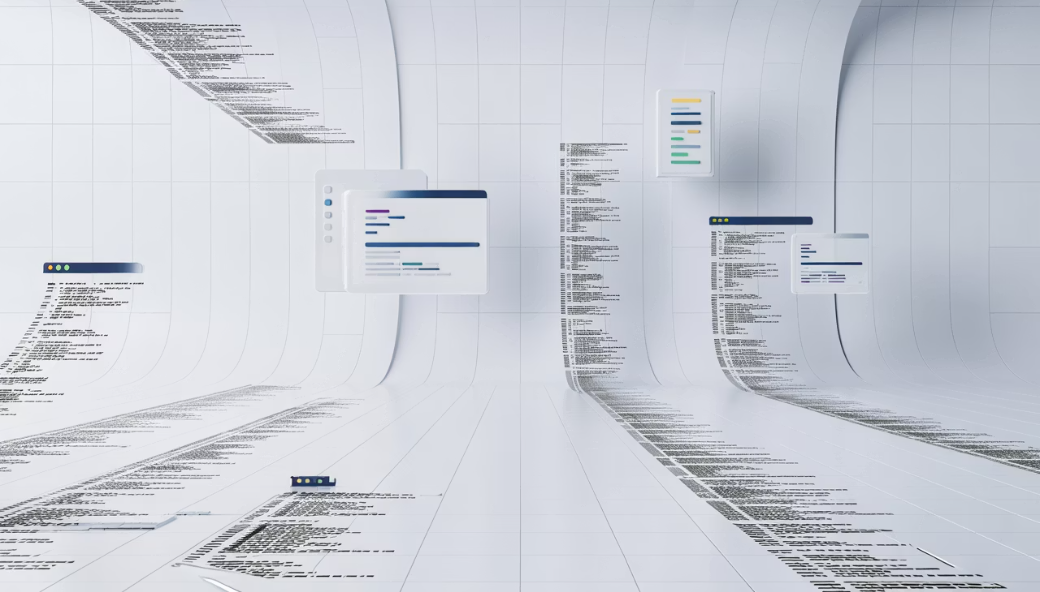

JavaScript Overview
JavaScript is used to make web pages interactive and dynamic.
It can respond to user actions like clicks or form inputs.
It allows adding features like sliders, pop-ups, and animations.
It works with HTML and CSS to create full, functional websites.

Slide 8


React Overview
React is a JavaScript library for building user interfaces.
It helps create reusable components for faster development.
It updates web pages quickly without reloading using a virtual DOM.
It’s widely used for making single-page and dynamic web apps.

Slide 9

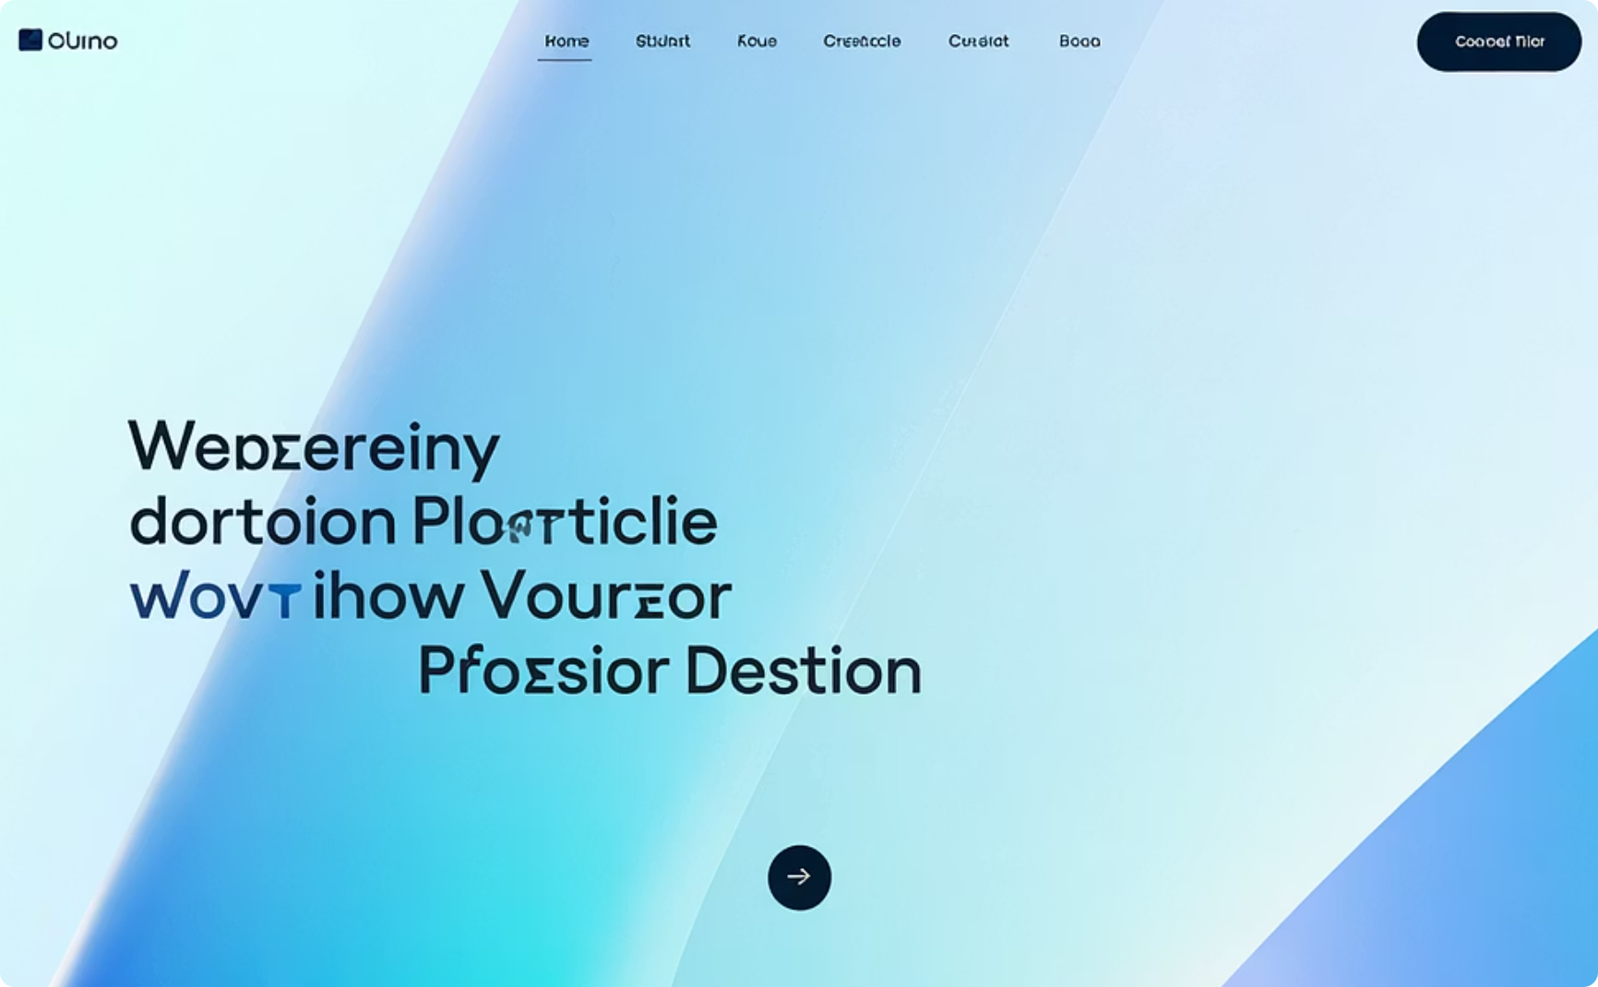
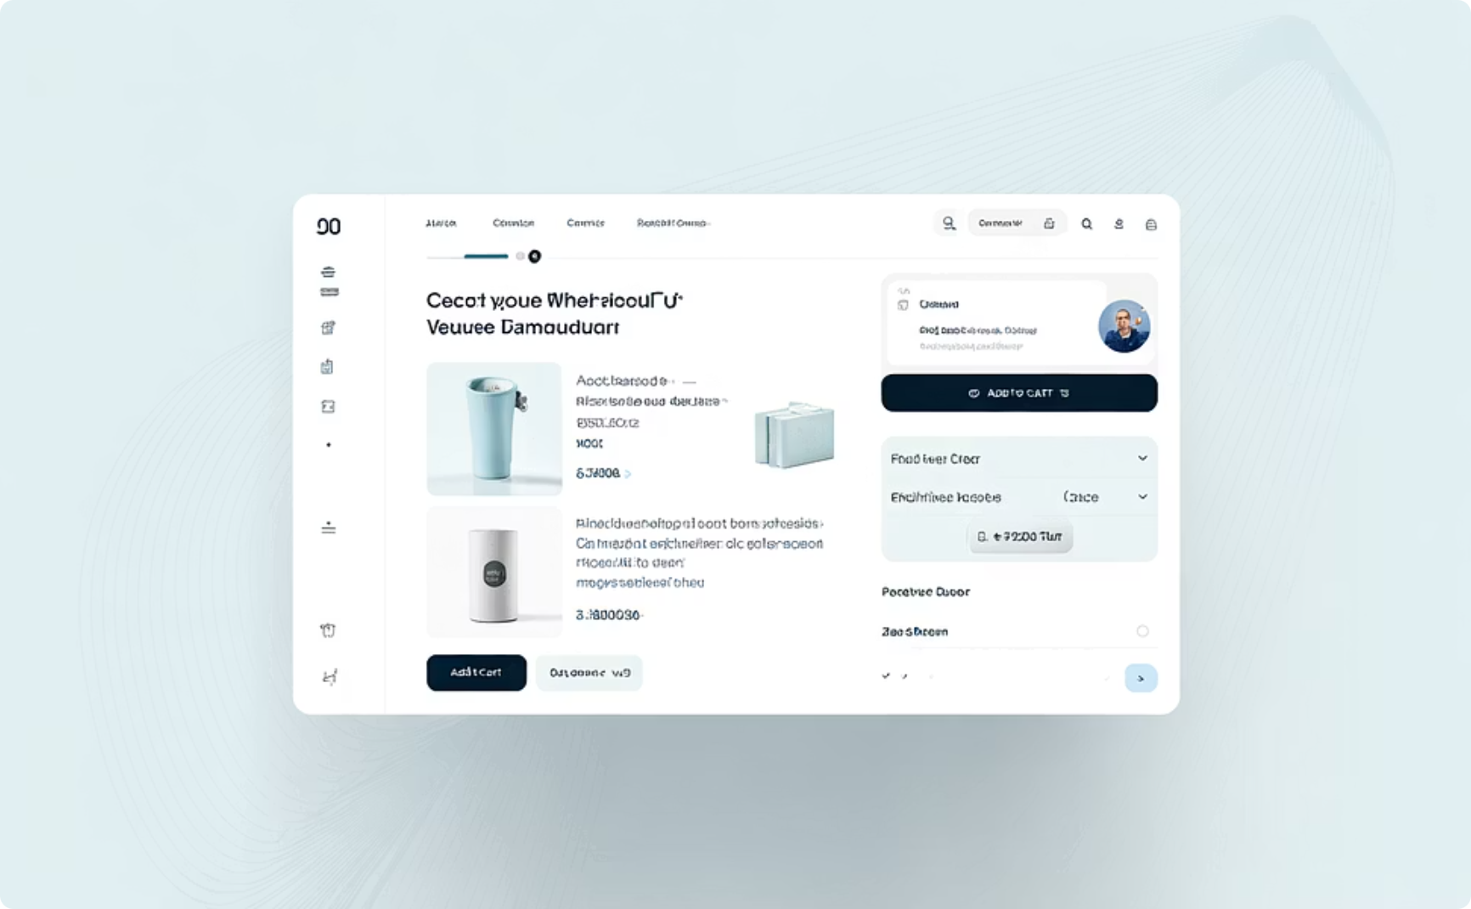
Projects I Made
i Built small projects: Portfolio Website, E-commerce Product Page.
Applied HTML, CSS, JavaScript, and React practically.
Improved confidence and creativity through each project.
Portfolio Website
E-commerce Product Page
Created to showcase my skills, projects, and contact details
Designed product listing and detail pages using HTML, CSS, and JavaScript.
Helps visitors know more about me and my work.
Made the layout responsive so it works well on all devices..

Slide 10

Benefits of using Frontend
Better User Experience: It makes websites easy and enjoyable to use.
Attractive Design: Frontend helps create beautiful and modern-looking web pages.
Responsive Layout: It allows websites to work smoothly on mobiles, tablets, and computers.
Fast Performance: A well-designed frontend makes websites load faster.
Strong First Impression: A good frontend design attracts and keeps users on the site.

Slide 11

use case of Frontend
Single Page Applications (SPAs)
Online Games:
E-commerce Platforms
React is ideal for SPAs where a smooth and fast user experience is crucial, such as social media platforms.
Frontend handles animations, buttons, and game visuals that users play in browsers.
The flexibility and scalability of the Frontend make it suitable for building complex e-commerce layouts.

Slide 12

Thank You!
Thank you for your time and attention.

